Slide 1

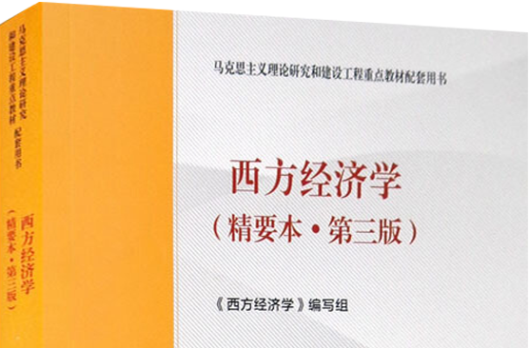







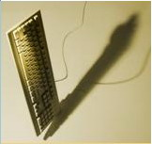
经济学基础
第一部分授课人： 曹历娟
caolj@njau.edu.cn

Slide 2
什么是经济学？
“经济学是一门研究人类一般生活事务的学问”
——马歇尔《经济学原理》
生活中处处离不开经济学：因为选择无处不在。
消费者的选择
小张有100元钱
用来改善伙食还是去看电影？
社会的选择
种多少粮食、生产多少衣服
谁去种粮食，谁去生产衣服
谁开法拉利跑车，谁将坐公共汽车
农户的选择
农户有一块2亩的地
是种玉米还是种棉花？
用有限的资源满足最大的欲望！

Slide 3
什么是经济学？
为什么选择无处不在？稀缺性
稀缺性（Scarcity)：社会拥有的资源（主要指生产要素，包括劳动、土地、资本、企业家精神和才能等）是有限的， 因而不能生产人们希望拥有的所有物品与劳务。
基本假设：
人类的欲望是无穷的
资源是有限的

Slide 4
什么是经济学？
人类欲望与资源稀缺的矛盾
终日奔波只为饥， 方才一饱便思衣。
衣食两般皆俱足， 又想娇容美貌妻。
取得美妻生下子， 恨无田地少根基。
买到田园多广阔， 出入无船少马骑。
槽头扣了骡和马， 叹无官职被人欺。
县丞主簿还嫌小， 又要朝中挂紫衣。
作了皇帝求仙术， 更想登天跨鹤飞。
若要世人心里足， 除是南柯一梦西。
清人胡澹庵编辑的《解人颐》一书中收录的《不知足》

Slide 5
什么是经济学？
面对稀缺性，我们必须做出选择（choices）。
我们做出的选择取决于我们面临的激励。
激励（incentive）是鼓励一个行动的奖赏，或者抑制一个行动的惩罚。
经济学（Economics）是一门社会科学，它研究个人、企业、政府和整个社会在面临稀缺性时做出的选择行为，以及那些影响选择的激励。

Slide 6

什么是经济学？
经济学的用途
帮助决策者高效率地配置所拥有的资源
帮助决策者规划、选择和评价公司战略和政府政策
经济学是指导人们做出合理选择的科学
选择所凭借的原则就是经济学的基本原理
为选择而进行的分析就是经济学的基本方法
只要这世界上还有愚昧和困苦，那么，经济学就不会是无益的。
——《悲惨世界》卷首语

Slide 7

第一讲
经济学导论
授课内容对应“马工程教材”的导论，“曼昆《经济学原理》”第1-3章

Slide 8

第一节 什么是经济学 本节将探索这些问题的答案：
经济学研究什么问题?
人们如何做出决策?
人们如何相互交易?
整体经济如何运行?
7

Slide 9
一、经济学研究什么问题
0
经济学: 研究社会如何管理自己的稀缺资源。
微观经济学：研究家庭和企业如何做出决策，以及它们如何在市场上相互交易
宏观经济学：研究整体经济现象，包括通货膨胀，失业和经济增长
这两个经济学的分支是密切相关的，也有所不同—它们研究不同的问题。
Notes:
8
You might want to elaborate a bit on some of the points made here. Some examples:
“How do people decide how much to work?” Time is scarce resource – there’s just not enough time to do everything we’d like to do. How do we decide how much of our time to spend working? There’s a tradeoff: the more time we spend working, the higher our income, and therefore the more stuff we can buy. But, the more time we spend working, the less time we have for leisure – hanging out with friends, going hiking, watching movies, etc. (You might want to ask your students how THEY decide how much time to spend working. Some will say it depends on how many classes they are taking, or the time requirements of the available jobs. But probably at least a few will say the wage – the higher the wage, the more worthwhile to work.)
“How do firms decide what kind of labor to hire?” Firms can hire unskilled or skilled workers. The skilled workers are more productive, but cost more than the unskilled workers.
“How do firms decide how much to produce?” Ask your students, and see if any of them say “it depends on the price of the product they sell.” (Probably some will say “it depends on whether there’s a lot of demand for the product”. To which you might respond “and if there’s a lot of demand for the product, what does that mean for the price that firms can get for the product?”)

Slide 10
经济学的两大研究疑问
0
一个社会的资源配置决策(选择)涉及如下几个方面：
生产什么(what)
哪些物品和服务，每种生产多少？
Notes:
9

Slide 11
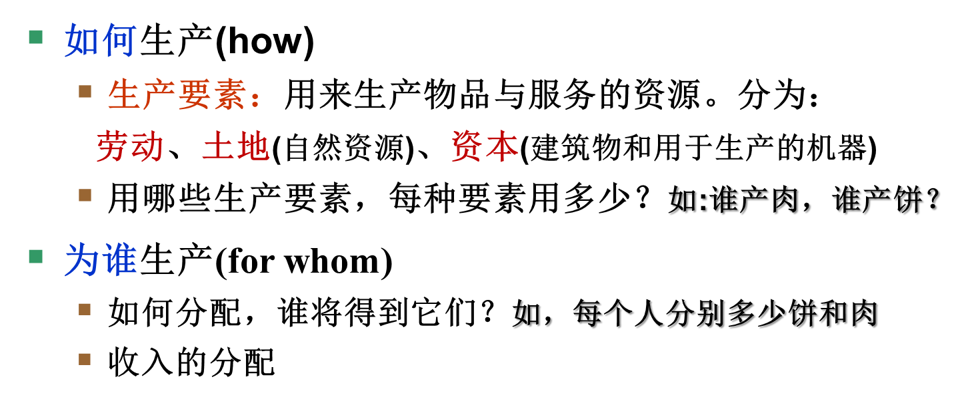
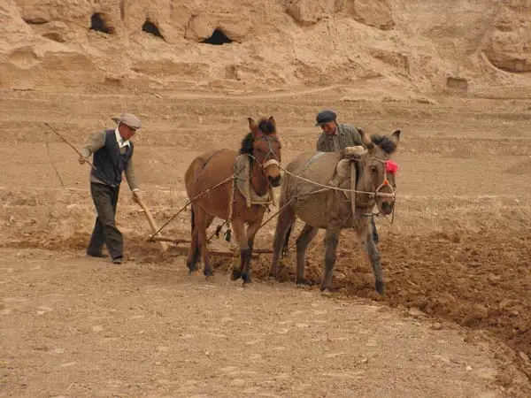
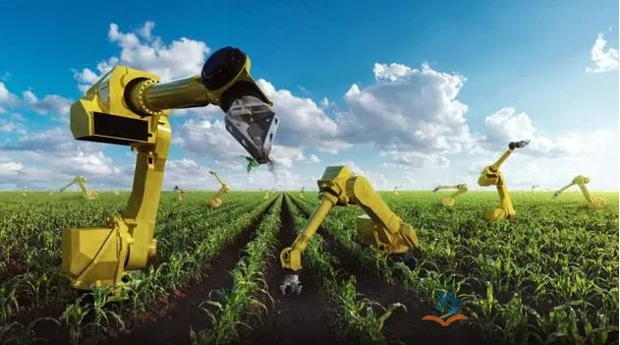
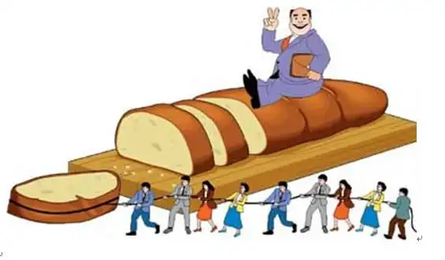
经济学的两大研究疑问

Slide 12
经济学的两大研究疑问
0
在众多社会中，大部分资源都分配给了个人/家庭，由个人来做出配置决策，而不是统一配置
每天，全球大约有70亿人都在做出涉及生产、交换或消费方面的决策
利己决策(self-interest decision)：人们基于个人利益做出决策——做出她/他认为的最好的决策
经济学要回答的第一个研究疑问是：人们的配置决策如何决定了生产什么、如何生产、为谁生产？
以决策为核心解释经济运行(物品和服务的生产与分配)的规律。这是它科学的一面
Notes:
11

Slide 13
经济学的两大研究疑问
0
经济学要回答的第二个研究疑问是：利己决策形成的资源配置结果(什么, 如何, 为谁)从社会角度来说也是合意的吗？
什么条件下是合意的？如果不合意，怎样利用规律来改善资源配置结果？这是它应用的一面
注意：经济学假定人们追求自身利益，并非教唆我们成为坚定的“精致的利己主义者”。他的主旨是悲悯的，它关注社会总体利益：既然每个人都想要实现自己的目标，那就帮助他们（社会）最大限度的实现各自的目标。
Notes:
12

Slide 14

经济学基本原理之： 二、人们如何做出决策
0
Notes:
13
Decision-making is at the heart of economics. The individual must decide how much to save for retirement, how much to spend on different goods and services, how many hours a week to work. The firm must decide how much to produce, what kind of labor to hire. Society as a whole must decide how much to spend on national defense (“guns”) versus how much to spend on consumer goods (“butter”).

Slide 15
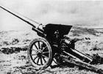
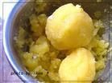
二、人们如何做出决策
0
原理一: 人们面临权衡取舍
所有决策都面临着权衡取舍。比如:
参加期中考试前一天晚上的聚会意味着更少的时间学习
想要更多的收入需要工作更长时间，这就使得休息时间减少
保护环境意味着生产消费物品的资源减少
现在与未来间的取舍：少壮不努力老大徒伤悲
【鸡汤】舍与得：”两利相权”，有得必有舍，有舍才有得

Slide 16
二、人们如何做出决策
0
原理一: 人们面临权衡取舍
社会面临一种重要的权衡取舍: 效率 vs. 平等
效率: 社会能从其稀缺资源中得到最大的利益
平等: 经济成果在社会成员中平均分配
权衡取舍：为使社会更加平等, 需要在富人与穷人之间重新分配收入。但这会减少工作与生产的激励，并缩小经济“蛋糕”的规模
Notes:
15
HEADS UP. The 5th edition uses “equality.” The fourth and earlier editions used “equity” here.
You may want to elaborate verbally on the last bullet to insure that the point is clear.
“Redistribute income from wealthy to poor” is accomplished through the progressive tax system, as well as social programs like food stamps and unemployment insurance that try to provide a safety net for people at the low end of the income distribution.
“But this reduces the incentive to work” – the reward for working hard is a high income. Taxes reduce this reward, and therefore reduce the incentive to work hard.

Slide 17
人们如何做出决策
原理二: 某种东西的成本是为了得到它所放弃的东西
人们做出决策时需要比较可供选择行动方案的成本与利益
成本（Cost）也可以翻译为代价，任何一种东西的机会成本是为了得到这种东西所放弃的东西
资源的稀缺性和多用途性是机会成本产生的原因
市场经济下，成本和利益多折算成货币量
课堂练习1：小张周一请事假看牙医，一共花了100元医疗费，他还因此被扣了200元的工资。问：他治疗牙齿的机会成本是多少钱？

Slide 18
人们如何做出决策
原理二:某种东西的成本是为了得到它所放弃的东西
一项决策要运用多项资源，应当是使用这多种资源的机会成本的总和。
例如：
上一年大学的机会成本不仅仅是学费，书籍，住房和伙食的钱全部加起来，还包括由于没有工作而损失的工资
看一场电影的机会成本不仅是票价，还包括你呆在剧院的时间的价值
Notes:
17
Here’s a fun tangent if you have the class time and are so inclined:
Ask your students about the saying “The best things in life are free.” Ask them to name some of these things that supposedly are free. Ask them what “free” means in this context. The idea here is to get them to see that even things without an explicit monetary cost are not truly “free” because they have an opportunity cost.
For example, when you ask them to name the “best things” that are “free,” they will respond with answers like love, sitting at the top of a mountain you just climbed and enjoying an awesome view, or maybe witnessing the joy of a child who has just been given a new toy. In each case, there is no explicit monetary cost, but there’s an opportunity cost.
For example, a day spent climbing a mountain represents a day of foregone wages. And the fact that the mountain offers the incredible view probably means that land has been set aside for a national park that might otherwise have been used to produce industrial chemicals, or for a subdivision of million-dollar homes.
With love, it’s less obvious, but if prodded enough, your students will be able to think of non-monetary costs associated with love. For example, you might not want to see the latest Ashton Kutcher film, you might think he’s the world’s worst actor. But your boyfriend/girlfriend/teenage daughter or other loved one is DYING to see it, they are BEGGING you to take them. So you take them. That’s true love, don’t you think? And it’s certainly not free.

Slide 19
人们如何做出决策
原理三: 理性人考虑边际量
理性人：
系统而有目的地尽最大努力实现其目标的人
注意：1 是否理性需从决策者自身的喜恶来看：鱼还是熊掌
【鸡汤】当试图体味他人苦难时，推己及人是褒义词；但当试图将自己的价值观刻板灌输给他人时，就令人讨厌了
2 一项理性决策可能事后来看并非最好：农民种什么
一项理性决策可能事后来看并非最好：农民种什么或2000年时大学生关于住房还教育的投资选择
3 在大量重复决策中达到理性：马歇尔“经济学是研究人们日常生活事务的学问”。

Slide 20
人们如何做出决策
原理三: 理性人考虑边际量
你会碰到 “是与否”的决策，但更常碰到“多少”决策:
当一个经理在考虑是否要增加1单位产量时, 她会比较需要增加的劳动力与原材料等成本和可以增加的销售收入
通过比较成本与利益的边际变动来做出决策
边际变动 – 对现有行动计划的微小增量调整
Rational people think at the margin.
案例：演唱会1000个座位，运作成本为10万元，每张票平均成本为100元。设演唱会开场后还有100张票，票务公司往往会以50元甚至更低的价格出售。Why?
理性人：增加一名观众的成本收益，即边际成本VS边际收益

Slide 21
人们如何做出决策
原理三: 理性人考虑边际量
边际上的选择
边际变动是指对现有行动计划的微小增量调整。
1. 边际成本（marginal cost）
增加一个活动的成本叫做边际成本，某个事物的边际成本是为了得到额外1单位该事物所必须放弃的东西。
边际成本是递增的，Eg:看电影与成绩。
2、边际收益（marginal benefit）
增加一个活动所带来的好处叫做边际收益。边际收益是拥有额外1单位事物所得到的东西。
边际收益的一个基本特点是递减的，eg:看电影的边际收益
20

Slide 22
人们如何做出决策
原理三: 理性人考虑边际量
3、理性选择
在许多情况下，个人和厂商通过考虑边际变量来作出最优决策。只有当一种行动的边际收益大于边际成本，一个理性的决策者才会采取该行为。
边际利益(MB) >边际成本(MC)时，增加这项活动
边际利益(MB) <边际成本(MC)时，减少这项活动
MB=MC时，资源配置数量刚刚好
“是与否”的决策：
如，2021年开通还是关停北京到南京的某个航班
考察总收益与总成本，或平均每个座位的收益与成本
“多少”的决策：
如，是否多卖一张机票
考察多提供一位乘客服务的收益增量和成本增量
21

Slide 23
人们如何做出决策
原理四: 人们会对激励做出反应
激励：引起一个人做出某种行为的某种东西，诸如惩罚或奖励的预期
理性人会对激励做出反应：改变利益和成本的事件会改变人们的决策，例如：
羊肉价格上升：买者减少消费；卖者增加生产销售
当汽油价格上涨时, 消费者会更多的购买混合动力汽车，更少购买耗油的越野车
当烟草税上升时，青少年吸烟人数会下降

Slide 24
人们如何做出决策
原理四: 人们会对激励做出反应
政策的直接影响与通过激励产生的间接的不太明显的影响
安全带的法律改变了一个司机的成本-收益计算 (萨姆.佩兹曼, 1975)
安全带降低了车祸代价(减少了伤亡的概率)
减少了缓慢而谨慎地开车的收益
人们更快速、更不谨慎地开车:
车祸的次数增加了
净结果: 司机死亡人数变动很小，而行人和骑自行车的死亡人数有所增加
23

Slide 25
主动学习 1 原理的应用
你准备出售一款福田野马，并且已经在这辆车的维修上面花了$1000。然而，车的变速器坏了，你能够选择再花$600将车修好，或者就此售出
在下面的情形中，你应该把变速器修好吗？并解释
A. 如果变速器正常，汽车价值是$6500 。如果不正常，则是$5700
B. 如果变速器正常，汽车价值是$6000 。如果不正常，则是$5500
24
Notes:
Most of these PowerPoint chapters have two or three Active Learning activities. They break up the lecture with a short in-class activity for immediate reinforcement, application, or assessment of the material in the preceding slides.
A good idea is to give students time to formulate their answers before asking for volunteers to share their answers with the class. When the questions or exercises are more complex, consider having them work in pairs.
Digression on class participation:
In general, it’s not a good idea to try to solicit participation by saying “Now who can tell me the answer to….”. The invariable result is regular participation by very few students – the quick thinkers who have the confidence to answer spontaneously in front of the class – while most students remain silent.
When students have a bit of time to think through their answers, they are more likely to be comfortable sharing their answers with you and the class.
Even better: try a simple, time-tested activity called “THINK-PAIR-SHARE.” Pair students up. Pose a question or problem. Have students work on the problem individually for a couple minutes. Then, allow a couple minutes to work in pairs: each student tries to explain to the other why his or her answer is correct, and the other offers feedback. In many cases, they come up with better answers by working together. Finally, ask for volunteers. Students are much more likely to participate since they have had the opportunity to “test” their answers on a classmate. And those who do not participate will at least have had the chance to share their answer with, and get feedback from, one other student.
Activities like these are useful to break up a lecture every 20 minutes or so. They help maintain students’ attention spans, and increase their comprehension of the material you cover. These activities are also useful for quick, informal assessment – often, they will alert you to problems (such as students not getting what you think they’re getting) which you can then correct before moving on to cover additional material.
End of digression.

Slide 26
主动学习 1 参考答案
修理变速器的成本= $600
A. 如果变速器正常，汽车价值是$6500 。如果不正常，则是$5700
修理变速器的收益= $800 ($6500 – 5700)
因此，修理变速器是值得的
B.如果变速器正常，汽车价值是$6000 。如果不正常，则是$5500
修理变速器的收益仅仅为$500
因此花费$600修理变速器是不值得的
25

Slide 27
主动学习 1 参考答案
思考:
你最初花在维修上的 $1000没有任何影响，重要的是边际修理（变速器）的收益与成本
由A情形到B情形激励的改变导致你决策的改变
26
Notes:
If you wish, you can omit this slide and just give this information to the class verbally.

Slide 28

经济学基本原理之： 三、人们如何相互交易
0
Notes:
27
Whether we’re talking about the U.S. economy, or the local economy, the term “economy” simply means a group of people interacting with each other.
These interactions play a critical role in the allocation of society’s scarce resources. For example, the interaction of buyers and sellers determines the prices of goods and the amounts produced and sold. These interactions are an important part of what economists study.

Slide 29
三、人们如何相互交易
原理 5 :贸易可以使每个人的状况都变得更好
国家和个人都能从相互交易中获益。
人们可以专门生产一种物品或劳务并用来交换其他物品或劳务，而不必自给自足
国家之间也能从贸易与专业化中受益
将他们生产的物品出口而得到一个更好的价格
从国外进口更便宜的物品而不用在国内自己生产
【思考与讨论】学校校园的旧自行车或旧书交易
Notes:
28
If each person had to grow his own food, make his own clothes, cut his own hair, we would have a world full of skinny, unfashionable poor people having bad hair days every day of the week.
It’s far more efficient for each person to specialize in producing a good or service, and then exchanging it with other people for the things they produce.
The statement “trade can make everyone better off” should not be hard to understand, if you think about it for a moment: Each of two parties would not voluntarily enter into an exchange if it made either of them worse off, now would they?
The same principles apply at the national and international level: International trade allows countries to sell their exports abroad and get a higher price, and to buy things from abroad more cheaply than they could produce at home.
In addition, trade gives a country’s consumers access to a greater variety of goods – including goods they might not be able to get at all. For example, U.S. consumers enjoy a variety of fresh produce year-round. This would not be possible without international trade.

Slide 30
三、人们如何相互交易
原理 6 :市场通常是组织经济活动的一种好方法
市场: 让买者与卖者在一起的任何安排 (不必要在同一个地点)
组织经济活动意味着需要决定
生产什么，生产多少
怎么生产
谁将得到它们
Notes:
29
A market economy is “decentralized,” meaning that there is no government committee that makes the decisions about what goods to produce and so forth. Instead, many households and firms make their own decisions:
* Each of many households decides who to work for and what goods to buy.
* Each of many firms decides whom to hire and what goods to produce.

Slide 31
三、人们如何相互交易
原理 6 :市场通常是组织经济活动的一种好方法
市场经济：许多企业和家庭在物品和劳务市场上相互交易，通过他们的分散决策来配置资源的经济
亚当.斯密在《国富论》（1776）中的著名观察结果：
家庭和企业仿佛被一只“看不见的手”所指引，在市场上相互交易，并增进整体经济的福利
Notes:
30
In all versions of this textbook except Brief Principles of Macroeconomics, market efficiency and the invisible hand are covered more thoroughly in Chapter 7.

Slide 32
三、人们如何相互交易
原理 6 :市场通常是组织经济活动的一种好方法
“看不见的手”通过价格体系来发挥作用:
买者与卖者之间的相互作用决定市场价格
每个价格即反映了物品对于买者的价值，也反映了生产物品的成本
在许多情况下，价格引导自利的家庭与企业做出使社会经济福利最大化的决策

Slide 33
三、人们如何相互交易
原理 7 :政府有时可以改善市场结果
政府的重要作用: 保护产权 (通过警察，法庭)
如果人们的财产存在很大的被侵犯的风险，那么他们便不愿意工作，生产，投资或者购买物品
eg:知识产权的保护
Notes:
32
[“Govt” is an abbreviation for government. Throughout all of the Premium PowerPoint chapters, I try to use abbreviations the way a thoughtful instructor would use them if writing on a chalkboard. If you prefer to spell the word out, just use your mouse to highlight “govt” and then type out the full word.]
Two examples of the idea in the second bullet point:
A restaurant won’t serve meals if customers do not pay before they leave.
A music company won’t produce CDs if too many people avoid paying by making illegal copies.
Many fledging market economies are struggling through the transition from central planning because they have not developed institutions that protect and enforce property rights. The British news magazine The Economist has lots of current examples of this. An older but still interesting example comes from a column that Mankiw wrote in the June 12, 2000 issue of Fortune magazine entitled “Ukraine: How Not To Run An Economy.”

Slide 34
三、人们如何相互交易
原理 7 :政府有时可以改善市场结果
市场失灵：市场本身不能有效配置资源的情况
原因：
外部性：生产或消费一个物品影响到旁观者的福利（比如：污染）
市场势力：单个买者或卖者有能显著影响市场价格的能力（比如，垄断）
在这些情况下，公共政策能增进效率
政府可以改变市场结果以促进公平
如果经济福利的市场分配结果不是合意的，税收或福利政策能改变经济“蛋糕”的分配方式

Slide 35
主动学习 2 问题讨论
政府在下述情形中发挥何种作用？政府的干预有助于结果的改善吗？
a. 公立学校
b.工作环境安全的监管
c.公共高速公路
d.专利法允许制药公司对急救药索取高价
34
Notes:
The items in this list are meant to get students thinking about Principles 6 and 7 in the context of specific examples, and to generate discussion rather than arrive at definitive answers.
NOTE: Discussing the entire list would consume a lot of class time (20-25 minutes). Two would suffice. Pick your favorite two and delete the others. Of course, you can skip this slide entirely if you wish to get through the chapter as quickly as possible.
Here are some notes which might help guide the discussion:
a. Public schools. The alternative would be private schools. The cost of education would be concentrated among those with school-aged children, rather than spread over all taxpayers, so the price per child would likely be high. Some families would not be able to afford to enroll their children in schools, and would either home-school the children or raise them without education. Is the benefit to society of having an educated population large enough to justify making people without children share in the cost? Could the private sector provide education more efficiently (either at lower cost or higher quality) than the public sector?
b. Workplace safety regulations. Without such regulations, would firms provide a safe environment for their workers? Some students will say “no – look at how bad working conditions are in poor countries which have no safety regulations.” Another view is dropping such regulations would make workers better off. Workers may view the safety of their work environment as part of their wage: the less safe the environment at a specific firm, the higher the wage the firm will have to offer to make workers willing to work there. If workers vary with respect to their tolerance for unsafe conditions, then workers with a high risk tolerance would be better off if given the option to work for higher wages in factories that aren’t as safe. Such workers would be worse off if the government required all firms to provide equally safe conditions.
c. Public highways. The alternative would be toll highways operated by the private sector. People who use highways more would pay more, and people that use them less would pay less, which seems fairer than having everyone pay equally for highways. (Actually, everyone does not pay equally - people who use public roads more buy more gas, and therefore pay more gas tax.) If there are external benefits to society of having a national highway system, then the private sector would under-provide this good.
d. Patent laws. I’ve kind of loaded the question with the wording on the slide. If you wish, change it to just “Patent laws.” Is it fair that drug companies charge such high prices for drugs that some people need to stay alive? If drug prices are regulated, how might pharmaceutical firms respond?

Slide 36

经济学基本原理之： 四、整体经济如何运行
0

Slide 37
四、整体经济如何运行
原理 8 :一国的生活水平取决于它生产物品与劳务的能力
各国不同时期生活水平的巨大差异：
发达国家的平均收入是发展中国家平均收入的十倍以上
全球大部分人口得以脱离贫困与饥饿也只是发生在近二、三年的事情
今天中国的生活水平比新中国成立之初发生了翻天覆地的变化
Notes:
36
“Rich countries” refers to countries like the U.S., Japan, and Germany.
“Poor countries” refers to countries like India, Indonesia, and Nigeria.

Slide 38
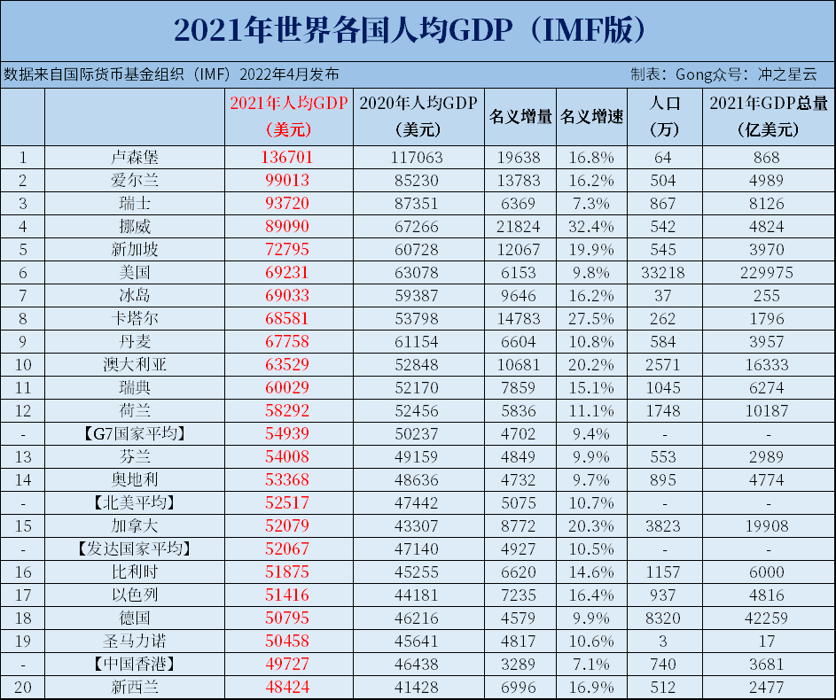

Slide 39
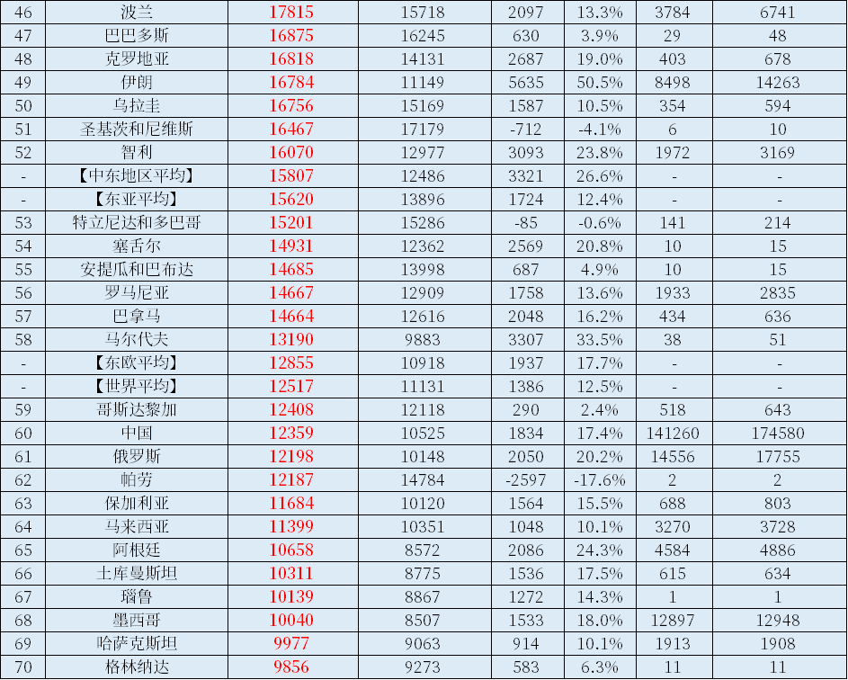

Slide 40
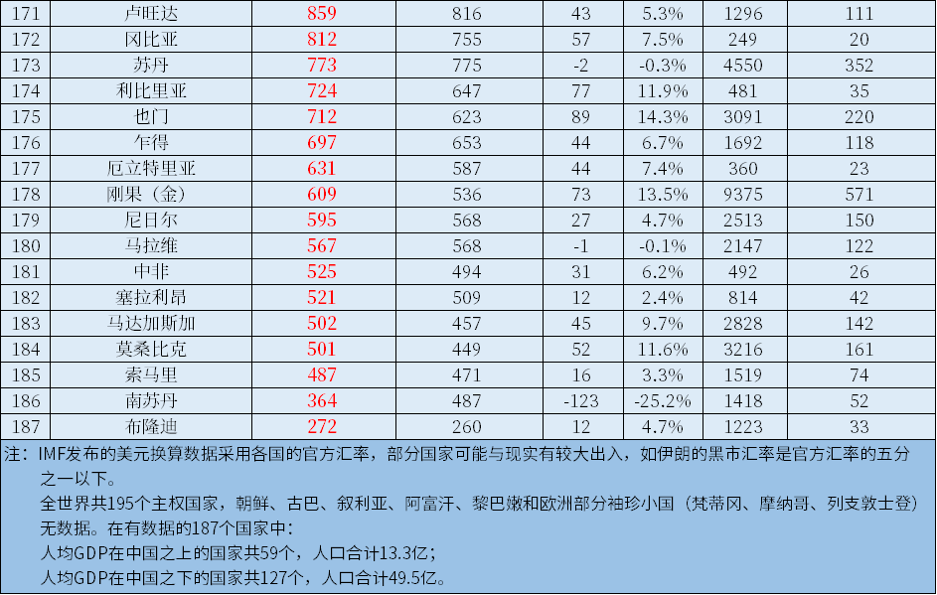

Slide 41
四、整体经济如何运行
原理 8 ：一国的生活水平取决于它生产物品与劳务的能力
决定生活水平的最重要因素：生产率，即每一单位劳动投入所生产的物品与劳务数量
生产率取决于设备，劳动者的技能以及可用的技术
其它因素（比如，工会组织，国外的竞争）对于生活水平的影响远远小于生产率
Implications:
要改善生活水平，关键是政策如何影响生产物品和劳务的能力。

Slide 42
四、整体经济如何运行
原理 9 :当政府发行了过多货币时，物价上升
通货膨胀：物价总水平的上升
【例子】1921年1月，德国一份日报价格为0.3马克，不到两年之后，即在1922年11月，一份同样的报纸价格为7000万马克，与此同时，经济中所有其他价格都以类似的程度上升，这个事件是历史上最惊人的通货膨胀的例子。
长期而言，通货膨胀总是由于货币数量的过度增长而导致货币价值的下降所引起
政府创造货币的速度越快，通胀率越高
Implications:决策者可以通过货币政策影响物品与劳务的需求

Slide 43
四、整体经济如何运行
原理 10 :社会面临通货膨胀与失业之间的短期权衡取舍
经济中货币量增加刺激了社会的整体支出水平，从而增加了对物品与劳务的需求。
需求增加随着时间推移，引起企业太高物价，但同时也鼓励企业雇佣更多工人，并生产出更多的物品与劳务。
雇佣更多的工人意味着更少的失业。
Implications:
决策者可以通过货币政策影响物品与劳务的需求
Notes:
42
While the long-run effect of increasing the quantity of money is inflation, the short-run effects are more complicated - and controversial. However, most mainstream economists believe the following: An increase in the quantity of money causes spending to rise, which causes prices to rise, which induces firms to produce more goods and services, which requires that they hire more workers. Hence, in the short-run, increasing the quantity of money causes inflation to rise, but unemployment to fall.
Of course, REDUCING the quantity of money would have the opposite effects (inflation would fall, while unemployment would rise) in the short run.
Keep in mind, though, the lesson from Principle #9: In the long run, changing the quantity of money only affects inflation. We will learn in a later chapter what determines the rate of unemployment in the long run, and we will see that it has nothing to do with the quantity of money.
The second bullet addresses the following point: In some decades, due to factors outside of the control of policymakers, inflation and unemployment are both high (e.g. 1970s) – or low (e.g. 1990s). Yet, given these other factors, policymakers can always reduce unemployment temporarily by creating more inflation, or vice versa.

Slide 45
参考资料*：如何阅读本书
1. 上课之前先读书
你将从课堂上领会更多东西
2. 要总结，而不是划重点线
划重点线是一种消极的做法，它不能帮助你理解或记忆。相反，用你自己的话总结每一节的内容，然后与该章结尾的内容提要相比较
Notes:
44
Most new college students have not been taught good study skills, yet we professors often assume they have such skills. This is the first of four slides that summarize an FYI box which describes proven strategies for learning and retention.
If you’re pressed for time, you can of course skip these slides, but please urge your students to read this FYI box.
But if you can spare 30 minutes of class time, there’s a very effective activity you can do in class which lets students see for themselves the power of active reading and teaching a partner. I describe this activity in the notes section of the fourth “FYI: How to Read Your Textbook” slide. This activity could replace showing these four slides in class, though your students should still read the corresponding FYI box in the book.

Slide 46
参考资料：如何阅读本书
考考自己
在你开始阅读下一节之前，试着解决上节的“即问即答”。并写下你的答案，与书后的答案进行核对。如果你答错了，也许你就需要复习一下该节
4. 实践，实践，再实践
练习每章结尾的复习题，它们是应付考试的好习题。你对新知识的运用越多，这些知识就会被掌握得越牢固
Notes:
45
If you do not like “They are often good practice for the exams,” please feel free to delete it. I’ve found, though, that students are more motivated to work practice problems when they think that doing so will help them earn a higher score on the exam.

Slide 47
参考资料：如何阅读本书
5. 上网
本书有一个极好的网络资源，包括测试练习，提高你画图能力的工具，视频以及其它资源可以帮助你更轻松有效地学习教材。访问网址:http://academic.cengage.com/economics/mankiw
6. 小组学习 与同学一起复习每个章节，互相测验，互相帮助理解材料
Notes:
46
If your classroom computer has a live internet connection, you should be able to click on the link and visit the textbook’s website. It’s worth taking 2-3 minutes of class time to show students the resources there.

Slide 48
参考资料：如何阅读本书
教其他人
学习某种东西的最好的方法莫过于再教其他人， 比如学友或朋友
8. 不要忽略现实世界中的例子 阅读每章的案例研究和新闻摘录专栏。它们将帮你看到新的术语，概念，模型，图表等是如何应用到现实世界中的。当你阅读报纸或看晚间新闻时，尝试着发现它们与你在教科书上所学知识的联系
Notes:
47
Here’s the activity I mentioned a few slides back. I have used it many times with terrific results.
Find two newspaper articles on topical economic issues. The articles must be (1) short enough that a beginning college student can read either of them in 10 minutes or less, (2) appropriate for the lay reader, and (3) very interesting. Make enough copies for all students in your class. Use different colored paper for each article, e.g. yellow for Article 1 and blue for Article 2. In class, instruct students to pair up. In each student pair, one student is assigned Article 1, the other assigned Article 2. Tell students they will have 15 minutes to read their assigned article. Then, each student will have 5 minutes to teach the contents of his or her article to his or her partner. Tell students it is not acceptable to merely give a paragraph-by-paragraph summary when teaching their articles to their partner.
Use your timer or a watch to announce when the 15 minutes are up and it’s time to start teaching. Five minutes later, announce when it’s time for the other student to teach his/her article. Five minutes later, stop the activity and re-group as a class. Ask your students the following four questions.
1) “How did you read your article, knowing that you were going to have to teach it to someone in a few minutes? Did you read it the same way as when you’re reading the paper on your own? Explain.” Ssummarize their responses on the board; you should come up with a list that includes the techniques they used to read the article. It will include things like “I took notes,” “I tried to identify the main point and the supporting information,” “I kept going back and re-reading sections of the article,” or “I kept jumping around the article, looking for connections.” After taking students responses, you can add a couple of your own if you like.
2) “Having read the article using these techniques, do you think you learned more from it and will retain more than if you read the article they way you would when you’re reading the paper on your own? Explain.” There should be a consensus that, yes, using these techniques leads to more learning and better retention.
3) “Are there any other contexts in which you might benefit from using these techniques while reading?” The students should realize the obvious answer: reading their textbooks.

Slide 49
第二节 经济学的基本模型 本节将探索这些问题的答案：
生产可能性边界与机会成本有什么联系？它还表示了什么其他概念？
为什么人们（还有国家）之间会选择经济上相互依存？
贸易怎样能使每个人都更好？
什么是绝对优势？什么是比较优势？这些概念有什么相同之处？它们又有什么不同之处？
48

Slide 50
我们的第一个模型：循环流量图
循环流量图：一个说明货币如何通过市场在家庭与企业之间流动的直观经济模型
两类主体：
家庭
企业
生产要素：经济体用来生产物品与劳务的资源，包括：
劳动
土地
资本（建筑物和用于生产的机器）
两个市场：
物品与劳务市场
生产要素市场

Slide 51
图1 ：循环流量图
家庭:
拥有并出售或出租生产要素给企业以获得收入
购买并消费物品与劳务
企业
家庭
企业：
购买或雇佣生产要素并用以生产物品与劳务
出售物品与劳务
Notes:
50
This and the following slide build the Circular-Flow Diagram piece by piece.

Slide 52
图1 ：循环流量图
收益
支出
物品与劳务市场
物品与劳务出售
物品与劳务购买
企业
家庭
生产要素
劳动，土地和资本
生产要素市场
工资，租金与利润
收入
Notes:
51
In this diagram, the green arrows represent flows of income/payments. The red arrows represent flows of goods & services (including services of the factors of production in the lower half of the diagram).
To keep the graph simple, we have omitted the government, financial system, and foreign sector, as discussed on the next slide.
You may wish to change the order in which the elements appear. To do so, look for “Custom Animation” in your version of PowerPoint.

Slide 53
模型二：生产可能性边界
0
生产可能性边界 （PPF）：表示在可得到的生产要素与生产技术既定时，一个经济所能生产的两种产品数量的各种组合的图形
例如：
两种物品：电脑与小麦
一种资源：劳动力（以小时为单位来衡量）
每月经济有50，000个劳动小时可用于生产

Slide 54
生产可能性边界的例子
0
生产一台电脑需要100个小时的劳动
生产一吨小麦需要10个小时的劳动
雇佣的劳动小时
生产
电脑
小麦
电脑
小麦
A
50,000
0
500
0
B
40,000
10,000
400
1,000
C
25,000
25,000
250
2,500
D
10,000
40,000
100
4,000
E
0
50,000
0
5,000
Notes:
53
Suggestion:
Show first row. Explain how we get the production numbers from the employment numbers. Then, show the rest of the employment numbers, and give students 3 minutes to compute the production numbers for each employment allocation.

Slide 55
生产可能性边界的例子
图表上点 | 生产
 | 电脑 | 小麦
A | 500 | 0
B | 400 | 1,000
C | 250 | 2,500
D | 100 | 4,000
E | 0 | 5,000
E
D
C
B
A

Slide 56
主动学习 1 不在生产可能性边界上的点
A.在图上找出代表（100台电脑，3000吨小麦）的点，并标作F。经济能生产出这样的两种产品数量组合吗？为什么？
B. 接下来，找出代表（300台电脑，3500吨小麦）的点，并标作G。经济能生产出这样的两种产品组合吗？为什么？
55
Notes:
This exercise leads students to discover for themselves that points under the PPF are possible but inefficient, while points above it are not possible.

Slide 57
主动学习 1 参考答案
点 F:100台电脑,3000吨小麦
点 F 需要40,000个小时的劳动。能够但没有效率：不用减少任何物品的生产便能获得更多的两种物品
F
56

Slide 58
主动学习 1 参考答案
点G:300 台电脑, 3500 吨小麦
点G需要65，000个小时的劳动，因为经济只有50，000个劳动小时，所以不可能。
G
57

Slide 59
关于生产可能性边界目前为止我们所知的内容
在生产可能性边界上的点（A-E)
能够达到
有效率：所以资源都已经充分利用
在生产可能性边界以内的点（F）
能够达到
没有效率：一些资源没有充分利用（比如，工人失业，厂房闲置等）
在生产可能性边界以外的点（G）
不能达到

Slide 60
生产可能性边界与机会成本
复习：机会成本是为了得到某种东西所必须放弃的东西
沿着生产可能性边界移动意味着将资源（比如劳动）从一种物品的生产转移到另一种物品的生产中
社会面临权衡取舍：得到更多的一种物品需要以更少的另一种物品为代价
生产可能性边界的斜率告诉我们以一种物品来衡量另一种物品的机会成本

Slide 61
生产可能性边界与机会成本
直线的斜率等于直线的横坐标向右移动一个单位时，直线的纵坐标变化的大小
–1000
斜率 =
= –10
100
本图，1台电脑的机会成本是10吨小麦
Notes:
60
Here, the “rise” is a negative number, because, as you move to the right, the line falls (meaning wheat output is reduced).
Moving to the right involves shifting resources from the production of wheat (which causes wheat output to fall) to the production of computers (which causes computer production to rise). Producing an additional computer requires the resources that would otherwise produce 10 tons of wheat.

Slide 62
主动学习 2 生产可能性边界与机会成本
在哪个国家布料的机会成本更小？
法国
中国
61
Notes:
This exercise reinforces the material on the preceding slide. It is especially useful if you plan to cover Chapter 3 (Interdependence and the Gains from Trade) after completing Chapter 2.

Slide 63
主动学习 2 参考答案
中国，因为它的生产可能性边界的斜率没有法国的陡峭
法国
中国
62
Notes:
There are two ways to get the answer.
The hard way is to compute the slope of both PPFs. The slope of France’s PPF equals -600/300 = -2, meaning that France must give up two units of wine to get an additional unit of cloth. The slope of England’s PPF = -200/300 = -2/3, meaning that England only must sacrifice 2/3 of a unit of wine to get an additional unit of cloth. Thus, the opportunity cost of cloth is lower in England than France.
The question, however, does not ask for the numerical values of the opportunity cost of cloth in the two countries. It only asks which country has a lower opportunity cost of cloth.
There is an easy way to determine the answer. Students must remember that the slope of the PPF equals the opportunity cost of the good measured on the horizontal axis. Then, students can simply “eyeball” the two PPFs to determine which is steepest. From the graphs show, it’s pretty easy to see that England’s PPF isn’t as steep, and therefore the opportunity cost of cloth is lower in England than in France.

Slide 64
经济增长和生产可能性边界
如果有额外的资源或技术进步，经济便能生产更多的电脑，小麦，或两种物品的组合
经济增长使生产可能性边界向外移动
.
Notes:
63
The PPF shows the tradeoff between the outputs of different goods at a given time, but the tradeoff can change over time.
For example, over time, the economy might get more workers (or more factories or more land). Or, a more efficient technology might be invented. Both events – an increase in the economy’s resources or an improvement in technology – cause an expansion in the set of opportunities. That is, both allow the economy to produce more of one or both goods.
This is a simple example of economic growth, an important subject that gets its own chapter in the macroeconomics portion of the textbook.
In the example shown on this slide, economic growth causes a parallel outward shift of the PPF. Since the new PPF is parallel to the old one, the tradeoff between the two goods is the same. However, this need not always be the case. For example, if a new technology had more impact on the computer industry than on the wheat industry, then the horizontal (computer) intercept would increase more than the vertical (wheat) intercept, and the PPF would become flatter: the opportunity cost of computers would fall, because the technology has made them relatively cheaper (relative to wheat). Going into more detail here is probably beyond the scope of this chapter.

Slide 65
生产可能性边界的形状
生产可能性边界可以是直线或曲线
取决于经济将资源从一个行业转向另一个行业时机会成本的变化情况
如果机会成本不变，那生产可能性边界为一条直线（在上述例子中，1台电脑的机会成本恒为10吨小麦）
如果一种物品的机会成本随着生产数量的增多而上升，那生产可能性边界为曲线

Slide 66
为什么生产可能性边界可能是曲线
当经济把资源从啤酒行业向山地自行车行业转移时：
生产可能性边界变得更加陡峭
山地自行车的机会成本也不断上升
啤酒
山地自行车

Slide 67
为什么生产可能性边界可能是曲线
在点A，大部分工人都在生产啤酒，即使这些工人更加适合于生产山地自行车。因此，为得到更多的自行车无需放弃太多啤酒
在点A,山地自行车的机会成本很小
A
啤酒
山地自行车
Notes:
66
Here, we are using “workers” for the more general “resources,” to keep things simple and consistent with the previous examples.

Slide 68
为什么生产可行性边界可能是曲线
在点B,大部分工人都在生产自行车，留在啤酒行业的工人是最好的酿酒师。生产更多的自行车需要将最好的酿酒师从啤酒行业转移出来，这会使啤酒产量大幅度降低
在点B,山地自行车的机会成本很高
啤酒
B
山地自行车

Slide 69
为什么生产可能性边界可能是曲线
因此，当不同的工人有不同的技能，多生产1单位物品的机会成本也不同，这使生产可能性边界为曲线
当经济中存在一些其他资源，或者机会成本不同的资源混合时，生产可能性边界也可能是曲线（例如，不同类型的土地有不同的用处）
Notes:
68
The bow-shaped PPF is more realistic. However, the linear PPF is simpler to work with, and we can learn a lot about how the economy works using the linear PPF. In Chapter 3, we will use a linear PPF to show how trade can make two countries (or two individuals) better off.
Note: In the “Problems and Applications” at the end of the chapter, problem 4 asks students to construct a PPF for an economy with three different workers (Larry, Moe, and Curly), each with a different opportunity cost. The PPF ends up having three line segments (one for each worker), which--very roughly--approximates a bow-shape. After students work through and understand this problem, it should not be hard for them to understand the following: the more different kinds of workers (or, more generally, resources) there are, the closer the PPF will resemble a smooth bow shape. In an actual economy like the U.S., there are millions of different workers with different opportunity costs, so a smooth bow-shaped PPF is a nearly perfect approximation to the actual PPF.

Slide 70
生产可能性边界：一个总结
生产可能性边界表示在可得到的生产要素与生产技术既定时，一个经济所能生产的两种产品数量的各种组合
生产可能性边界阐释了权衡取舍与机会成本，效率与无效率，失业和经济增长等的思想
曲状的生产可能性边界意味着递增的机会成本

Slide 71

模型三：相互依存性与比较优势
0
你每天都在享用世界上许多素不相识的人向你提供的物品与劳务，而其中绝大多数人你根本不认识
来自俄亥俄州克里夫兰的发胶
来自中国台湾的移动电话
来自中国的衬衫
来自肯尼亚的咖啡

Slide 72
二、相互依存性
第一章所强调的经济学十大原理之一：贸易可以使每个人的状况都变得更好
现在我们开始学习为什么人们（还有国家）之间会选择相互依存？他们又是如何从贸易中获益的？

Slide 73
我们的例子
0
两个国家：中国和美国
两种物品：电脑和小麦
一种资源：劳动，用小时为单位衡量
我们分析中国和美国将分别生产和消费多少物品
如果两个国家都选择自给自足
如果两个国家之间进行贸易
Notes:
72
The lessons illustrated by this international trade example also apply to trade between two individual producers. Note that this chapter in the textbook does the reverse: It develops the lessons in the context of an example involving two individual producers, and then states that the lessons also apply to international trade. So, between this PowerPoint and the textbook chapter, students will see the same concepts and lessons developed in two different but entirely consistent approaches and examples.
The example here is highly contrived and unrealistic in order to illustrate complex concepts as simply as possible. The example has some qualities that make it especially valuable:
* The two goods are fundamentally different (one is agricultural, the other manufactured), which makes gains from trade based on comparative advantage very likely. An example using more similar goods, say laptop computers and MP3 players, would not be appropriate for this chapter because it would more likely give rise to inter-industry trade, and the gains would likely arise from a source other than comparative advantage (probably increasing returns to scale).
* In the example here, it turns out that the U.S. has an absolute advantage in both goods, yet both countries gain from trade. Students see, therefore, that comparative advantage, not absolute advantage, is what’s necessary for trade to be mutually beneficial.
* In the real world, one often sees gains from trade based on comparative advantage occurring between countries that are very different – such as between rich industrialized countries and poor developing countries. This example shows that trade based on comparative advantage can also occur between countries that are at similar levels of industrialization and income. (Of course, the U.S. and Japan are very different; but they are far more similar than are, say, the U.S. and Botswana.)

Slide 74
美国的生产可能性
0
美国每个月有50，000个小时的劳动能用在生产上
生产1台电脑需要100个小时的劳动
生产1吨小麦需要10个小时的劳动
Notes:
73
If you just covered Chapter 2, point out to your students that the U.S. PPF here is the same as in the Chapter 2 PowerPoint.
Warn students that, in a few moments, they will be asked to derive Japan’s PPF. They will need to follow the same steps that you are about to show for deriving the U.S. PPF.

Slide 75
美国的生产可能性曲线
0
小麦 (吨)
美国每个月能生产500台电脑，或者5000吨小麦，或者生产可能性曲线上的其它组合
5,000
4,000
3,000
2,000
1,000
电脑（台）
0
100
200
300
400
500
Notes:
74
Deriving the intercepts, or endpoints of the PPF:
The U.S. has 50,000 labor hours.
It takes 100 hours to produce a computer. If the U.S. uses all its labor to produce computers, then it will produce 50,000/100 = 500 computers. Hence, the horizontal intercept is (500 computers, 0 wheat).
It takes 10 hours to produce a ton of wheat. If the U.S. uses all its labor to produce wheat, then it will produce 50,000/10 = 5000 tons of wheat. Hence, the vertical intercept is (0 computers, 5000 tons of wheat).
The PPF is the straight line that connects the two endpoints.

Slide 76
不存在贸易的美国
0
小麦 (吨)
如果美国在两种物品上各花费一半的劳动时间，那最终将会生产和消费250台电脑和2500吨小麦
5,000
4,000
.
3,000
2,000
1,000
电脑（台）
0
100
200
300
400
500
Notes:
75
Of course, the U.S. could choose a different point. The actual choice will depend on the preferences of society. (In the following chapter – on supply and demand – we will learn what determines how much of each good society produces.)
Important note for students: Without trade, a country consumes what it produces.

Slide 77
主动学习 1 中国的生产可能性曲线
利用下述信息画出中国的生产可能性曲线:
中国每个月有30，000个小时的劳动能用在生产上
生产1台电脑需要125个小时的劳动
生产1吨小麦需要25个小时的劳动
电脑的数量画在横轴，小麦的数量画在纵轴
76
Notes:
Using this information to draw Japan’s PPF requires a calculator (or the ability to do long division).
If your students have the “gutted handout” of these slides, they can draw their PPF on the axes provided on the following slide.
This activity should take only 3 minutes of class time. It’s good practice & review for students, and helps break up the lecture.

Slide 78
中国的生产可能性曲线
0
小麦 (吨)
中国每个月能生产240台电脑，或者1200吨小麦，或者生产可能性曲线上的其他组合
2,000
1200
1,000
0
电脑（台）
100
200
240
300
Notes:
77
Horizontal intercept: (30,000 labor-hours)/(125 hours per computer) = 240 computers.
Vertical intercept: (30,000 labor-hours)/(25 hours per ton of wheat) = 1200 tons of wheat.

Slide 79
不存在贸易的中国
0
小麦 (吨)
如果中国在两种物品上各花费一半的劳动时间，那它最终将生产和消费120台电脑和600吨小麦
2,000
1,000
0
电脑（台）
100
200
300

Slide 80
存在贸易与不存在贸易条件下的消费
0
不存在贸易：
美国的消费者总共消费250台电脑和2500吨小麦
中国的消费者总共消费120台电脑和600吨小麦
我们比较存在贸易与不存在贸易条件下的消费
首先，我们需要知道两个国家电脑和小麦的产量和贸易量

Slide 81
主动学习 2 贸易条件下的生产
1. 假设美国生产3400吨小麦，那剩余的劳动时间还能生产多少电脑？在美国的生产可能性曲线上标出该点
2. 假设中国生产240台电脑，那剩余的劳动时间还能生产多少小麦？在中国的生产可能性曲线上标出该点
80
Notes:
Give your students a few minutes to solve these problems before showing the answers on the next slides. This will break up the lecture, get the students involved, and give them practice with “word problems.”
It is not necessary that all students finish both problems before moving on. It’s fine if most finish the first, and a few finish the second. However, the second problem is easy for most students.
Note that most students will need a calculator to solve the first problem.

Slide 82
贸易条件下美国的生产
0
小麦 (吨)
5,000
生产3400吨小麦需要34，000个劳动小时
4,000
剩下的16，000个劳动小时可以生产160台电脑
3,000
2,000
1,000
电脑（台）
0
100
200
300
400
500
Notes:
81
Point out to students that the red dot represents the combination (160 computers, 3400 tons of wheat). We will assume that this is the combination the U.S. produces in the scenario in which the U.S. trades.

Slide 83
贸易条件下中国的生产
0
小麦(吨)
中国生产240台电脑需要30，000个劳动小时
2,000
因此，中国的小麦产量为0
1,000
0
电脑（台）
100
200
300
Notes:
82
The red dot represents the combination (240 computers, 0 tons wheat). We will assume this is the combination that Japan produces.
Point out that, just because Japan is not producing any wheat does not mean that Japan’s consumers must all go on the Atkins diet (which shuns bread and other foods made from wheat). When trade is allowed, Japan can trade some of its computers for wheat produced in another country.

Slide 84
基本的国际贸易术语
0
出口品：在国内生产而在国外销售的物品
出口：把国内生产的物品卖到国外去
进口品：在国外生产而在国内销售的物品
进口：购买在其它国家生产的产品
Notes:
83
These terms are so basic that many instructors skip this slide.
There’s a subtle point that you might want to mention (if you’re anal like me), or that your students might ask about (especially if tourism is an important part of your local economy).
Someone from Germany or South Korea visits Las Vegas and spends $200 on a pair of tickets to a show. How should we classify this and other expenditures by foreign tourists on lodging and entertainment while they are vacationing here?
Answer: we count it in U.S. exports. It doesn’t matter that the service was consumed here. What matters is that it was produced here but sold to a foreign buyer.
Hence, a more precise definition of exports would be goods and serviced produced here and purchased by foreign buyers. This stricter definition of exports doesn’t care whether the good or service was consumed in the buyer’s home country or in the exporting country.
Similarly, a stricter and more precise definition of imports would include purchases by domestic residents of goods and services produced abroad – including entertainment and lodging services that tourists from the U.S. consume in the foreign countries they visit.

Slide 85
主动学习 3 贸易条件下的消费
假设美国出口700吨小麦到中国，并从中国进口110台电脑（这也意味着中国进口700吨小麦，出口110台电脑）
最终在美国电脑和小麦分别消费多少？在美国的生产可能性曲线上标出该点
最终在中国电脑和小麦分别消费多少？在中国的生产可能性曲线上标出该点
84
Notes:
Some students need help figuring out that consumption of a good is the difference between the amount produced and the amount exported.

Slide 86
贸易条件下美国的消费
0
小麦(吨)
电脑
小麦
5,000
生产
160
3400
+ 进口
110
0
4,000
– 出口
0
700
= 消费总量
270
2700
3,000
2,000
1,000
电脑(台）
0
100
200
300
400
500
Notes:
85
The red point again represents production.
Trade un-tethers consumption from production. The light blue point represents consumption. Notice that the consumption point is above the PPF. Without trade, it would not be possible to consume this combination of the two goods!
In a sense, international trade is like technological progress: it allows society to produce quantities of goods that would otherwise not be possible.

Slide 87
贸易条件下中国的消费
0
电脑
小麦
小麦 (吨)
生产
240
0
+ 进口
0
700
2,000
– 出口
110
0
= 消费总量
130
700
1,000
0
电脑（台）
100
200
300
Notes:
86
Again, the light blue point representing consumption is above the PPF. Without trade, it would not be possible to consume this combination of the goods.

Slide 88
贸易使两个国家都更好
0
美国
没有贸易时的消费
有贸易时的消费
贸易的利益
电脑
250
270
20
小麦
2,500
2,700
200
中国
没有贸易时的消费
有贸易时的消费
贸易的利益
电脑
120
130
10
小麦
600
700
100
Notes:
87
These tables summarize the gains from trade for both countries.

Slide 89
这些好处来自何方？
0
绝对优势：用比另一个生产者更少的投入生产某种物品的能力
美国在生产小麦上有绝对优势：美国生产1吨小麦需要10个劳动小时，而在中国需要25个劳动小时
如果每个国家在一种物品的生产上具有绝对优势，并专门生产这种物品，那两个国家最终都将从贸易中得到利益
Notes:
88
The last bullet point states that gains from trade will arise if each country has an absolute advantage in something. We will see next, though, that absolute advantage is not required for both countries to gain from trade.

Slide 90
这些好处来自何方？
0
哪个国家在生产电脑上有绝对优势？
生产1台电脑：在中国需要125个劳动小时，而在美国仅仅需要100个劳动小时
美国在两种物品的生产上都具有绝对优势！
那为什么中国会专门生产电脑？为什么两个国家都能从贸易中得到利益？

Slide 91
物品成本的两种度量方法
0
当每个国家以它的最低成本专门生产某种物品时，两个国家都能从贸易中获益
绝对优势度量生产一种物品所需投入的成本
回忆：成本的另一种度量方法是机会成本
在我们的例子中，1台电脑的机会成本是将生产1台电脑上所需的劳动时间用在生产小麦上所能生产的小麦数量

Slide 92
机会成本与比较优势
0
比较优势：一个生产者以低于另一个生产者的机会成本生产一种物品的能力
哪个国家在生产电脑上具有比较优势
为回答这个问题，必须知道各个国家生产1台电脑的机会成本

Slide 93
机会成本与比较优势
0
生产1台电脑的机会成本：
美国是10吨小麦，因为美国生产1台电脑需要100个劳动小时，而100个劳动小时可以生产10吨小麦
中国是5吨小麦，因为中国生产1台电脑需要125个小时，而125个小时能够生产5吨小麦
因此，中国在生产电脑上有比较优势
总结：绝对优势并不意味着比较优势！

Slide 94
比较优势与贸易
0
贸易的利益来源于比较优势（机会成本的不同）
当每个国家专门生产它具有比较优势的物品时，所有国家的总产量会更高，世界的“经济蛋糕”也会更大
这也同样适用于个体生产者（比如农民和牧场工人）专业生产不同的产品，并彼此贸易

Slide 95
主动学习 4 绝对优势与比较优势
阿根廷和巴西每个月都有10，000个劳动小时
在阿根廷，
生产1磅咖啡需要2个小时
生产1瓶酒需要4个小时
在巴西，
生产1磅咖啡需要1个小时
生产1瓶酒需要5个小时
哪个国家在生产咖啡上有绝对优势？哪个国家在生产酒上有比较优势？
94
Notes:
Allow a few minutes for students to work on this problem. Ask for volunteers to share their answers.
Variation: Before asking for volunteers, instruct students to compare their answers with their neighbors. Not everyone will volunteer to explain their answer to the class, but everyone will at least get to explain his or her answer to a classmate.

Slide 96
主动学习 4 参考答案
巴西在生产咖啡上有绝对优势：
巴西生产1磅咖啡仅需要1个劳动小时，而阿根廷需要两个
阿根廷在生产酒上有比较优势：
阿根廷生产1瓶酒的机会成本是2磅咖啡，因为生产1瓶酒需要4个小时，而4个小时可以生产2磅咖啡
巴西生产1瓶酒的机会成本是5磅咖啡
95

Slide 97
未回答的问题
0
我们关于每个国家生产，贸易，消费的物品数量和国家之间小麦和电脑贸易的价格做了许多假设
在现实世界中，这些数量和价格是被两个国家的消费者的偏好，生产技术以及资源禀赋决定的
我们将在下章开始这些的学习
因为现在我们的目标只是说明贸易怎样使每个人的状况变得更好
Notes:
96
The 5th edition adds a brief explanation of the range of prices that will permit gains from trade, in the context of the farmer-rancher example.
The second bullet point mentions technology and resources. In our example, the technology is how many labor-hours are required to produce each good. The resources are simply the quantity of labor-hours available in each country.
In the following chapter (on supply & demand), students will begin their study of how prices and quantities are determined.

Slide 98
例题
经济学原理的应用
上大学的机会成本有哪些？
近五年，全国考研报名人数翻了近一倍。试运用经济学的基本原理，分析考研人数激增的原因。
举出社会面临权衡取舍的例子。
水是生活必需品。一杯水的边际收益是大还是小？

Slide 99
例题
美国每个月有50000个小时的劳动能用在生产上。生产1台电脑需要100个小时的劳动，生产1吨小麦需要10个小时的劳动。请画出美国的生产可能性边界。中国每个月有30000个小时的劳动能用在生产上，生产1台电脑需要125个小时的劳动生产1吨小麦需要25个小时的劳动。
请画出美国的生产可能性边界和中国的生产可能性边界。
哪个国家在生产电脑上有绝对优势？
哪个国家在生产电脑上有比较优势？
哪个国家会出口电脑？哪个国家会出口小麦？

